Slide 1
Customer Shopping Analysis (2021-2023)
Customer data analysis project
Team member : Karunakaran R and Dharun RR
Email id :rkarunakaranraja@gmail.com and dharunrio7@gmail.com
Batch : 12th May CDA
Project team id : PTID-CDA-SEP-25-722
Project id : PRDA-05(Customer data analysis)

Slide 2
Agenda
Introduction
Dataset Description
Tools & Methodology
SQL Results
Excel Analysis
Power BI Dashboard
Insights & Recommendations
Conclusion

Slide 3
Introduction
Our project is to analysis the shopping patterns based on gender, age, product category and payment methods.
To provide business insights.
We have taken 10 different shopping malls purchase data.
Analysis which age groups purchase maximum products.
Analysis which type of payment method they have done.
Analysis which gender bought maximum products etc..

Slide 4
Dataset
we have 1000 number customers data.
The dataset column attribute are 10.
Invoice _ no combination of letter “I” and a 6 digits integer.
Customer _ id combination of letter “c” and a 6 digits integer.
Gender contains string variable of the customer gender.
Age contains positive integer of the customer age.
Category contains string variable of the category of purchased products.
Quantity of each product (item) per transaction.
Price of the products per unit in Turkish liras (TL).
Payment _ method contains string variable of the payment methods like cash, credit card or debit card.
Invoice _ date the day when a transaction was generated.
Shopping _ malls contains string variable of the name of the mall where the transaction was made.

Slide 5
Tools & Methodology
SQL –> For querying and data cleaning.
Excel –> Pivot tables for aggregation.
Power BI –> For dashboard creation.

Slide 6
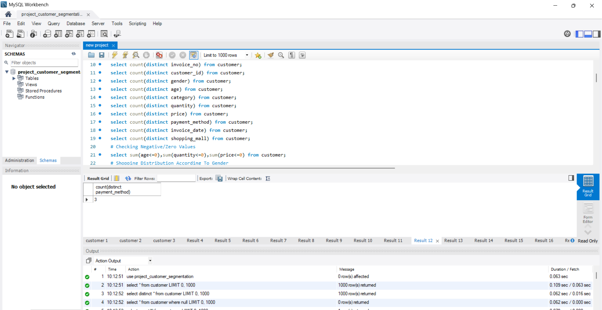
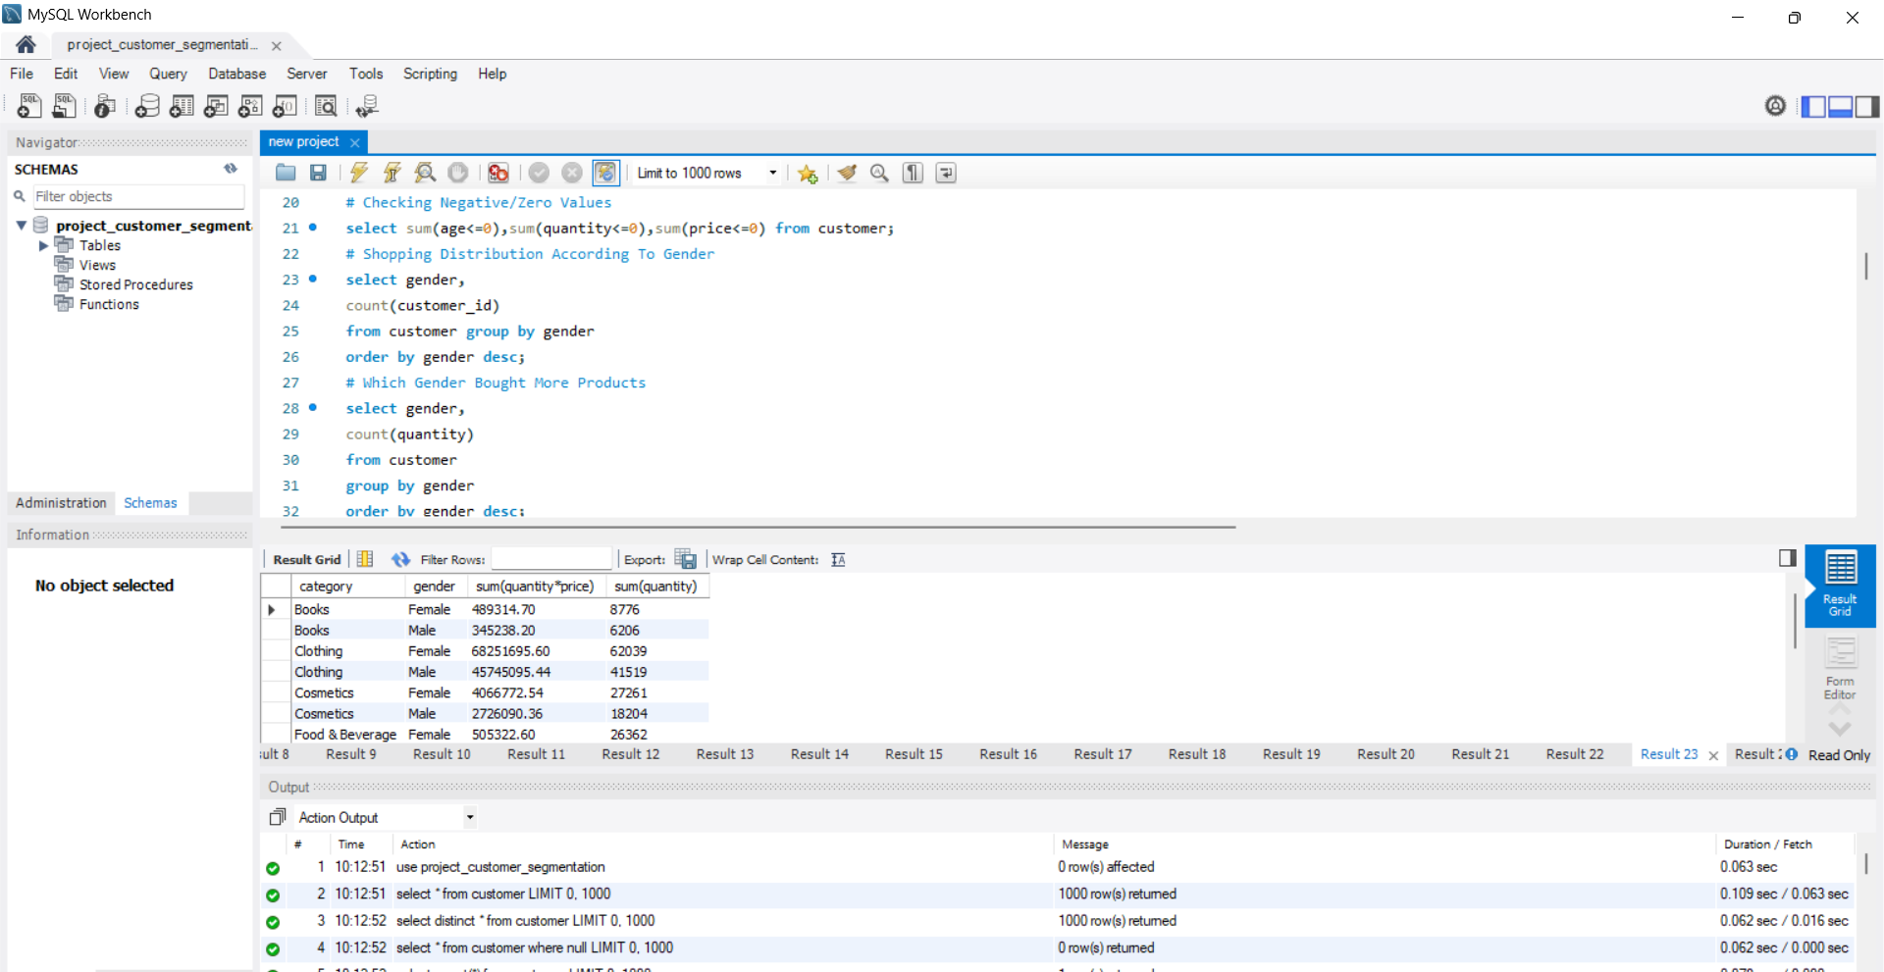
SQL Results
The above are two task which we have done using SQL.

Slide 7
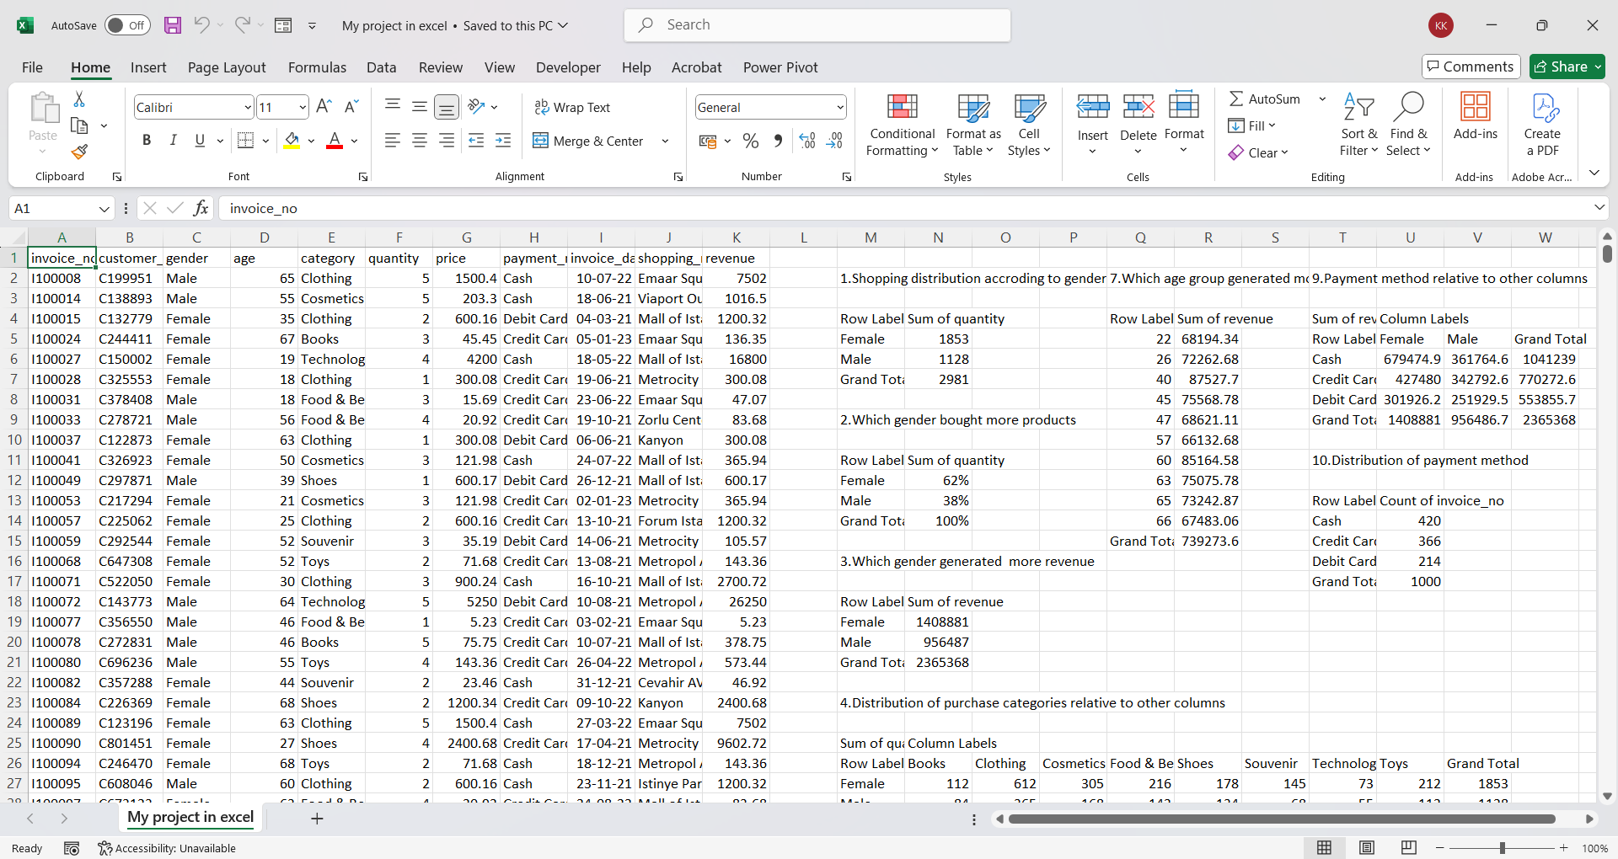
Excel pivot table

Slide 8
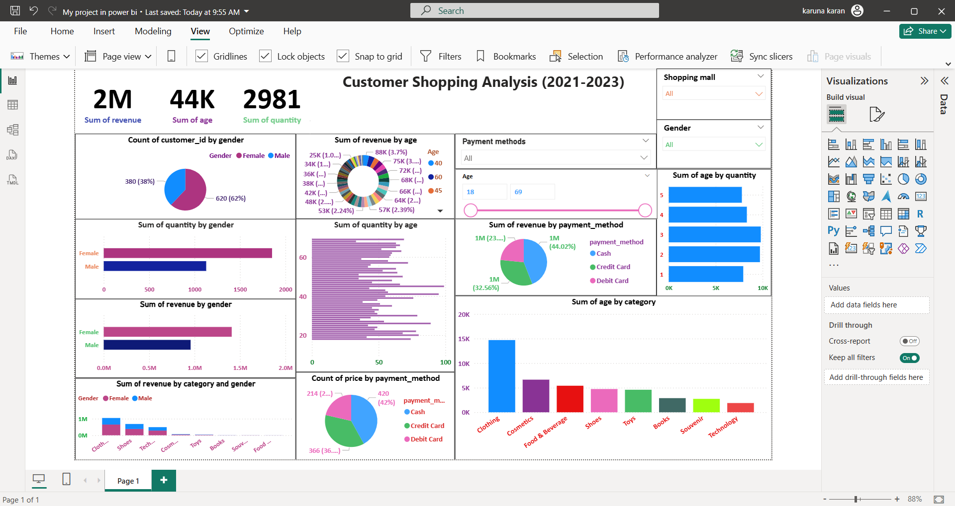
Power BI dashboard

Slide 9
Insights & Recommendations
Females spends 20% more than males –> Marketing campaigns can target females to sales maximum products.
Age groups 21-25 is most profitable –> Focus on giving discount offers.
Debit card most used payment method –> Optimize debit card offers.
Clothing & electronics categories dominate –> keeps maximum of stock

Slide 10
Conclusion
Finally we conclude our project by using SQL, Excel, Power Bi.
We analysis 10 different shopping malls and gives insights and recommendations for business growth.
We have given results which helps businesses in decision making on “stock planning, promotions, payment offers.

Slide 11
Thank you

